Slide 1


Presentation On
The Future Begins Here!
Final Assessment for DSP-IT (Web Design) BTIT-Backend and Frontend for Students
Front end (BTIT- FE) and Back end (BTIT-BE)
Group 4: Jigme Drakpa
Tshering Yangzom
Tandin Zam
Tshering Samdrup
THE BETA PARK STRICTLY CONFIDENTIAL (INTERNAL CIRCULATION ONLY)

Slide 2



1
Backend
Get
Post
Put
Delete
Topic Outlines
2
Frontend
View
Delete
Edit
Result
THE BETA PARK STRICTLY CONFIDENTIAL (INTERNAL CIRCULATION ONLY)

Slide 3
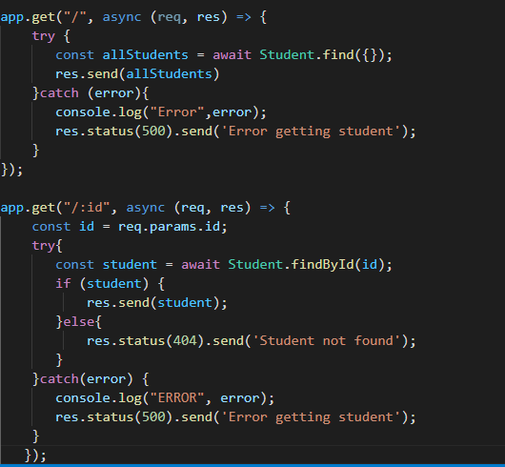
Get
THE BETA PARK STRICTLY CONFIDENTIAL (INTERNAL CIRCULATION ONLY)

Slide 4
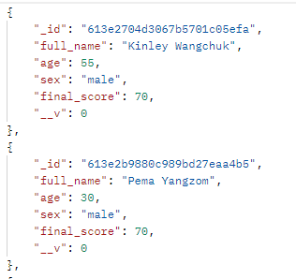
Get
THE BETA PARK STRICTLY CONFIDENTIAL (INTERNAL CIRCULATION ONLY)

Slide 5
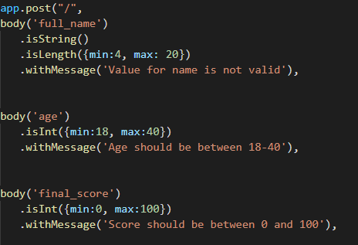
Post
THE BETA PARK STRICTLY CONFIDENTIAL (INTERNAL CIRCULATION ONLY)

Slide 6
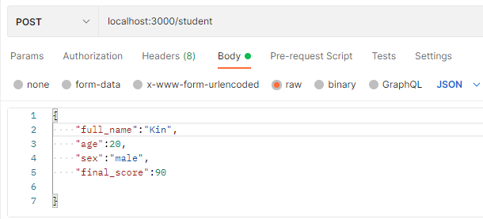
Post
THE BETA PARK STRICTLY CONFIDENTIAL (INTERNAL CIRCULATION ONLY)

Slide 7
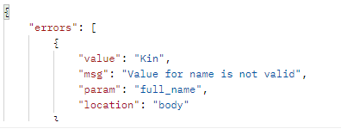
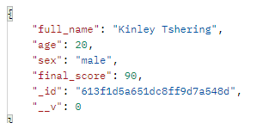
Post
THE BETA PARK STRICTLY CONFIDENTIAL (INTERNAL CIRCULATION ONLY)

Slide 8
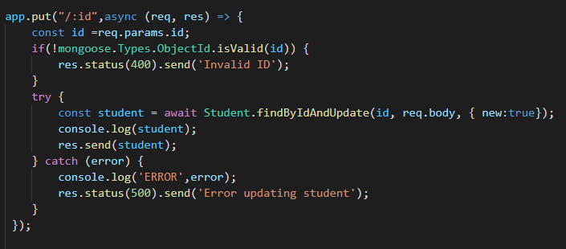
Put
THE BETA PARK STRICTLY CONFIDENTIAL (INTERNAL CIRCULATION ONLY)

Slide 9
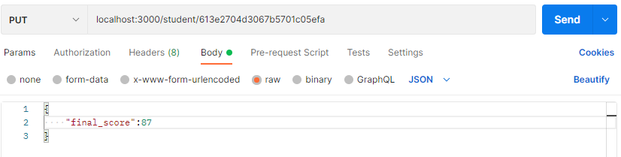
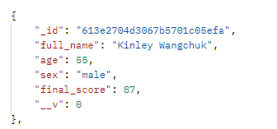
Put
THE BETA PARK STRICTLY CONFIDENTIAL (INTERNAL CIRCULATION ONLY)

Slide 10
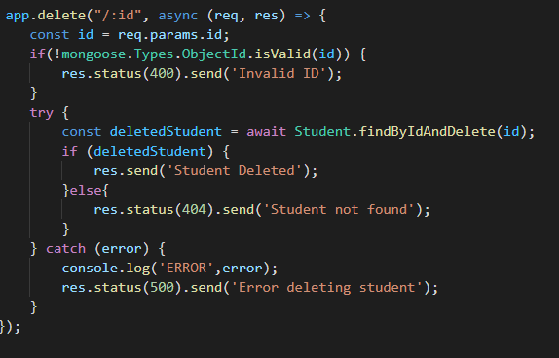
Delete
THE BETA PARK STRICTLY CONFIDENTIAL (INTERNAL CIRCULATION ONLY)

Slide 11
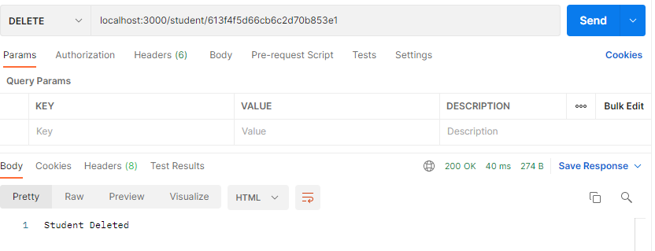
Delete
THE BETA PARK STRICTLY CONFIDENTIAL (INTERNAL CIRCULATION ONLY)

Slide 12

frontend
View
Delete
Edit
Result
THE BETA PARK STRICTLY CONFIDENTIAL (INTERNAL CIRCULATION ONLY)

Slide 13
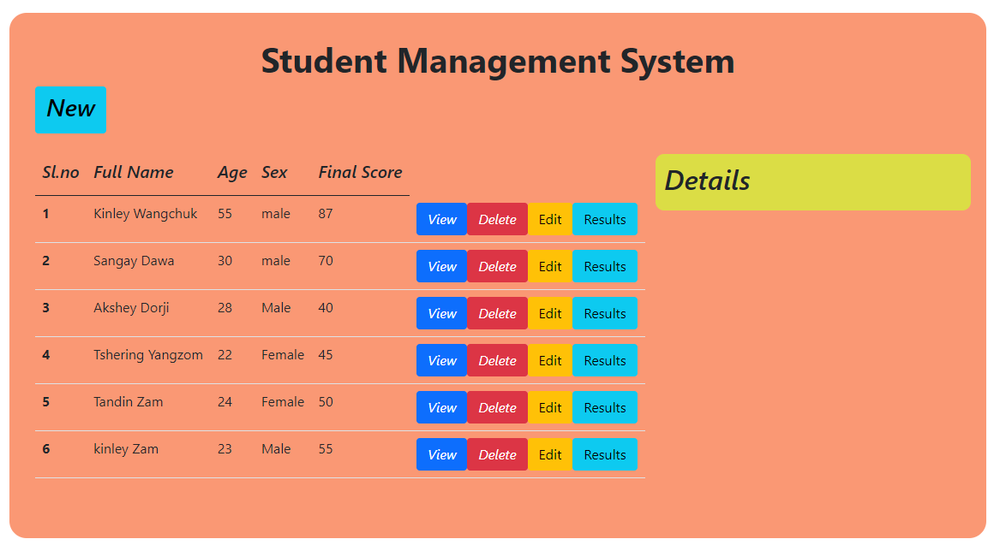
View
THE BETA PARK STRICTLY CONFIDENTIAL (INTERNAL CIRCULATION ONLY)

Slide 14
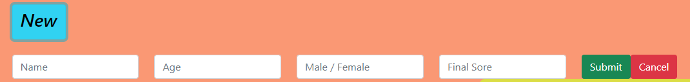
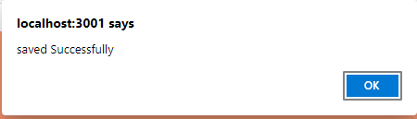
New
THE BETA PARK STRICTLY CONFIDENTIAL (INTERNAL CIRCULATION ONLY)

Slide 15
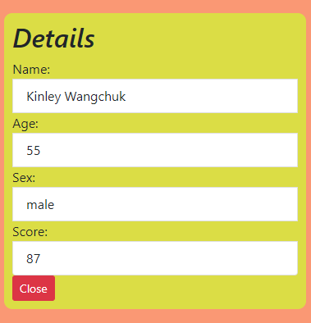
View
THE BETA PARK STRICTLY CONFIDENTIAL (INTERNAL CIRCULATION ONLY)

Slide 16
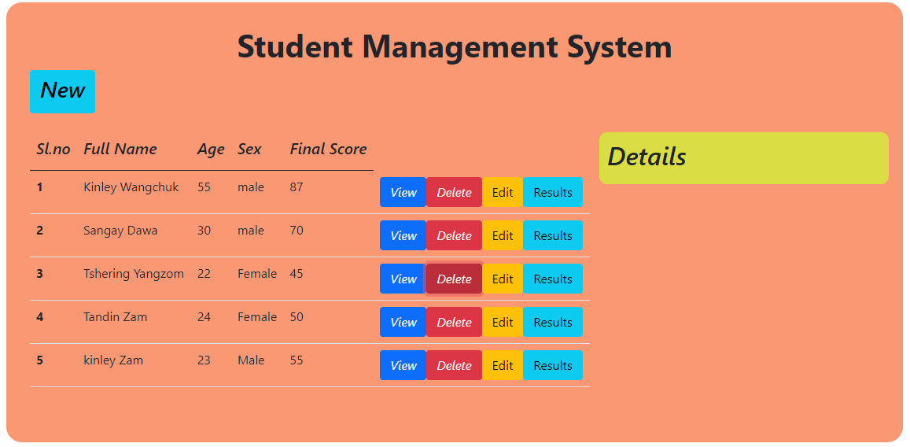
Delete
THE BETA PARK STRICTLY CONFIDENTIAL (INTERNAL CIRCULATION ONLY)

Slide 17
Thank You
THE BETA PARK STRICTLY CONFIDENTIAL (INTERNAL CIRCULATION ONLY)

